Slide 1




Egyptian Sign Language (ESL) Real-Time Translator
“Bridging Communication Gaps for the Deaf and Hard of Hearing”

Slide 2

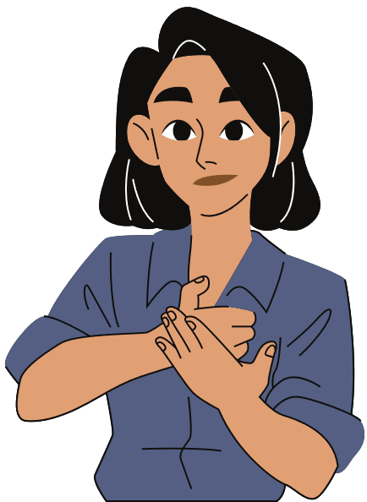
Outline
Introduction
Problem Statement
Objectives
Literature Review & Research Gaps
Dataset Creation
Tools & Frameworks
Methodology
Results
GUI
Applications
Future Work & Scalability
Conclusion

Slide 3

Introduction
For over 1.1 million Deaf and Hard of Hearing (DHH) individuals in Egypt, Egyptian Sign Language (ESL) is their voice—yet technology has largely ignored it. While ASL and BSL benefit from advanced systems, ESL remains underrepresented, limiting access to education, healthcare, and daily life.
Our project introduces a real-time ESL translator that recognizes full-word gestures, interprets cultural expressions, and displays accurate Arabic translations. Using MediaPipe Holistic and a lightweight LSTM model, we built a fast, accessible sign-to-text system.
We recorded 400 ESL signs, each with 20 samples—16 for training and 4 for testing.

Slide 4

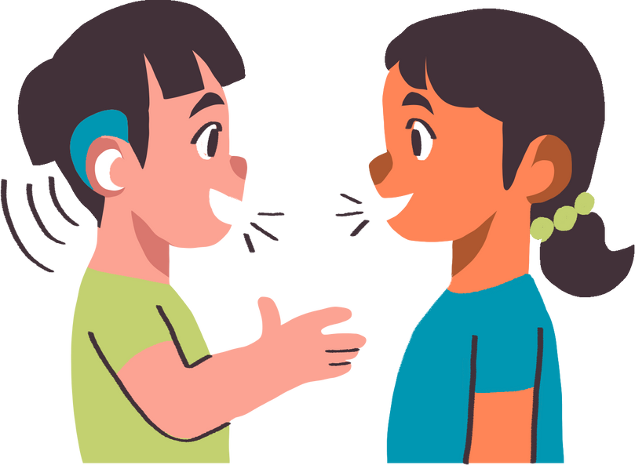
Problem Statement
Lack of Real-Time Applications
Technical Limitations
No real-time ESL translation systems, limiting accessibility and immediate communication for the Deaf and Hard of Hearing (DHH) community.
Existing models fail to capture dynamic gestures (hand + face + body).
Linguistic Gaps
Data Scarcity
No standardized signs for Egyptian idioms (e.g., "[تحال تحاليل دم , نبض قلب , ميزان حرارة]").
No public ESL dataset; ASL datasets lack cultural relevance.

Slide 5
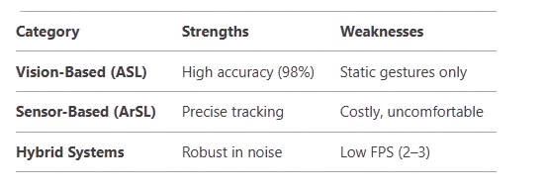
Literature Review & Research Gaps
Our Contributions:
Dynamic Phrase Recognition: Full sentences, not isolated words.
Cultural Relevance: ESL-specific idioms and regional variations.
Scalability: Modular design for adding new signs.

Slide 6
End-to-End Dataset Creation

Slide 7
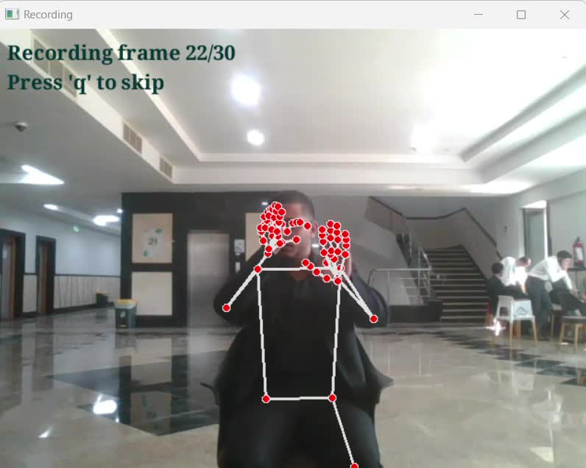
Dataset Creation
Dataset Creation
400 ESL words and phrases.
6,000+ videos recorded by the team using an FHD webcam.
20 samples per sign: 16 for training , 4 for testing
Each sample is a 30-frame sequence representing dynamic gestures.
Structured & Searchable
Labels linked to SignIDs through a well-organized Excel sheet, enabling easy updates and clean model mapping
Show 3-second countdown.
Extract 3D landmarks (pose, hands) using MediaPipe.
Draw landmarks for visual feedback.
Press 'q' to skip or quit anytime.

Slide 8
Feature Extraction using MediaPipe Holistic
MediaPipe Holistic provides robust 3D keypoint tracking across body parts:
*Landmarks per frame:
33 Pose
21 Left Hand
21 Right Hand
→ Total: 75 landmarks
*Each landmark contains (x, y, z) coordinates
→ 75 × 3 = 225 values per frame
*Temporal Resolution: 30 FPS
*Each gesture sample = 30 frames → input shape: (30, 225)
*Data Format: Saved as .npy files, organized by train/{SignID}/ and test/{SignID}/

Slide 9
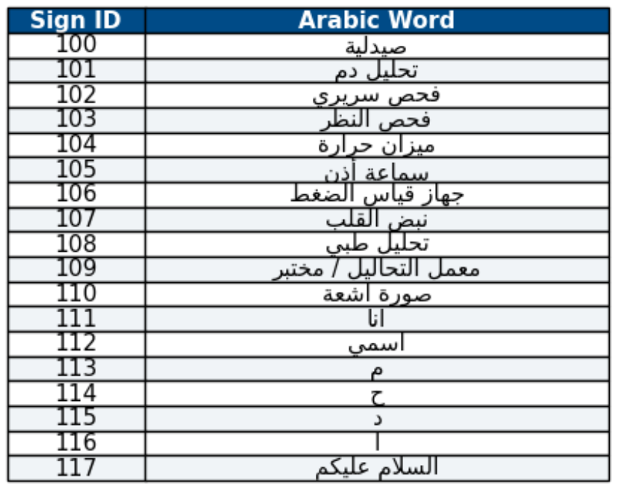
Sample Signs from Our Collected Dataset

Slide 10
Final Deployment Approach
(Real-Time Translation)
Objective:
Deploying a lightweight and efficient model trained on our custom MediaPipe Holistic dataset for real-time Arabic Sign Language recognition and seamless on-screen translation.
Key Features:
Input: 3D landmarks from MediaPipe Holistic (hands, face, body)
Model: Stacked LSTM trained on keypoint sequences
Output: Live gesture-to-Arabic translation over video stream

Slide 11
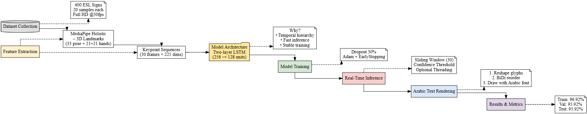
Pipeline

Slide 12
LSTM Model Architecture

Slide 13
Real-Time Inference Pipeline
Arabic Text Rendering System
*Live webcam capture via OpenCV
*Each frame is passed to MediaPipe Holistic for keypoint extraction
* A sliding buffer of 30 frames is maintained
* When full → converted into (30, 225) tensor → fed into LSTM
*Confidence thresholding:
* Predictions below a defined confidence level are not displayed
* Reduces noise and boosts user trust
*Optional threading:
* Prevents freezes or input lag
From Model Output to Display:
Predicted class index → mapped to Arabic label (from a static list)
arabic_reshaper: Fixes character joining
python-bidi: Applies right-to-left display
PIL + OpenCV: Renders text onto video frame
Supports:
Up to 4-word phrases
Native Arabic font: NotoNaskhArabic-Bold.ttf

Slide 14
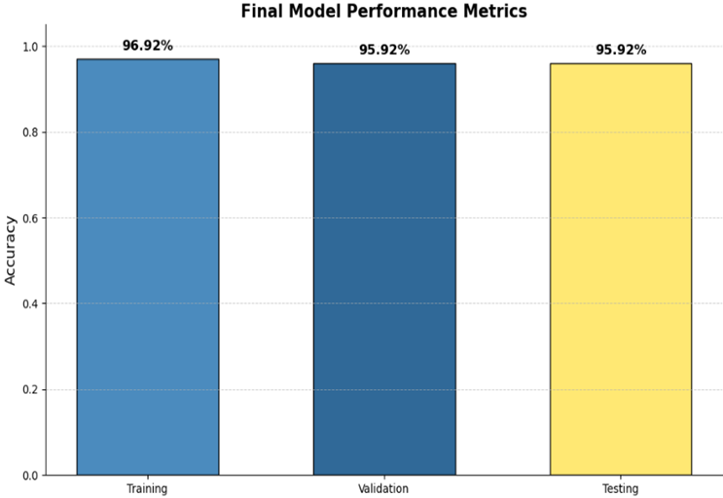
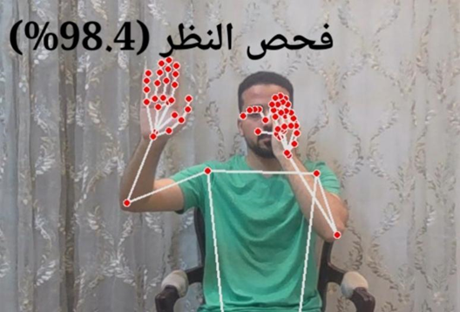
Results
MediaPipe + LSTM Accuracy
Live prediction of sign

Slide 15
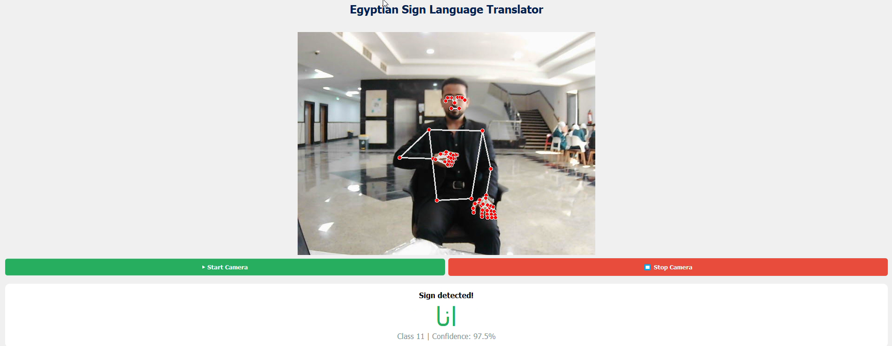
GUI

Slide 16


Applications
Education
Public Services
Classroom Integration: Enables real-time interaction between deaf students and teachers, translating ESL gestures into text/speech during lessons.
E-Learning Tools: Integrates with platforms like Microsoft Teams or Zoom to provide live captions for virtual classroom
Government Offices: Used in banks, courts, and municipal centers to assist DHH citizens.
Transportation Hubs: Airports and train stations deploy the translator for wayfinding assistance.

Slide 17


Applications cont.
Healthcare
Workplace Inclusion
Patient-Doctor Communication: Allows DHH patients to describe symptoms via gestures (e.g., "أنا عندي صداع").
Emergency Services: First responders use the app to understand urgent needs in real time
Corporate Accessibility: Assists DHH employees in meetings, training sessions, and daily communication.
Vocational Training: Translates technical manuals and instructional materials into ESL.

Slide 18
Future Work
Expand Vocabulary Coverage:
Grow the dataset from 400 to over 1,500 signs Including slang, idioms, and region-specific expressions.
Speech recognition:
Add speech recognition to convert Arabic voice input into ESL signs.
Deploy Mobile Application:
Port the application to Android and iOS using TensorFlow Lite or ONNX Mobile to Make it accessible to users in rural and underserved areas.
Introduce Custom Sign Learning:
Let users record new signs and map them to phrases and Include expert review before adding new signs to the dataset.

Slide 19
Conclusion
Our project developed the first real-time Egyptian Sign Language (ESL) translator, tailored to the cultural and linguistic needs of Egypt’s Deaf and Hard of Hearing community. Built around a two-layer LSTM model and MediaPipe Holistic, the system recognizes full-phrase gestures with high accuracy and real-time speed. A custom dataset of 6,000+ samples across 400 signs was created, with structured labeling and Arabic GUI support. The result is a scalable, efficient, and accessible tool—achieved without complex hardware or large teams.

Slide 20

Resources
[1] A. N. B. I. Ahmed, “Real-Time ASL Recognition Using CNNs,” Journal of AI Applications, vol. 10, no. 2, pp. 1205–1227, 2023.
[2] H. Mokhtar, K. Elsayed, and A. Ali, “Lightweight CNN for Arabic Sign Language Recognition,”
IJAITCSE, vol. 3, no. 7, pp. 952–960, 2021.
[3] M. Al-Ghamdi et al., “Hybrid CNN-RNN for Arabic Sign Language Recognition,” Heliyon, vol. 9, no. 4, p. e10460, 2023.
[4] Y. Chen et al., “Real-Time Sign Language Recognition Using YOLO and MediaPipe,” Sensors, vol. 24, no. 10, p. 3112, 2024.
[5] S. Rahman et al., “Vision Transformers for Sign Language Recognition,” Neural Computing and Applications, vol. 35, no. 12, pp. 8871–8885, 2023.
[6] J. Smith et al., “Sensor Gloves for ASL Recognition,” Sensors, vol. 24, no. 11, p. 3683, 2023.
[7] L. Johnson et al., “Low-Cost Sensor Gloves for Real-Time ASL Translation,” Journal of Assistive Technologies, vol. 17, no. 2, pp. 45–59, 2023.
[8] Q. Wang et al., “Transformer-Based Sign Language Recognition,” arXiv preprint, arXiv:2107.13647, 2021.

Slide 21
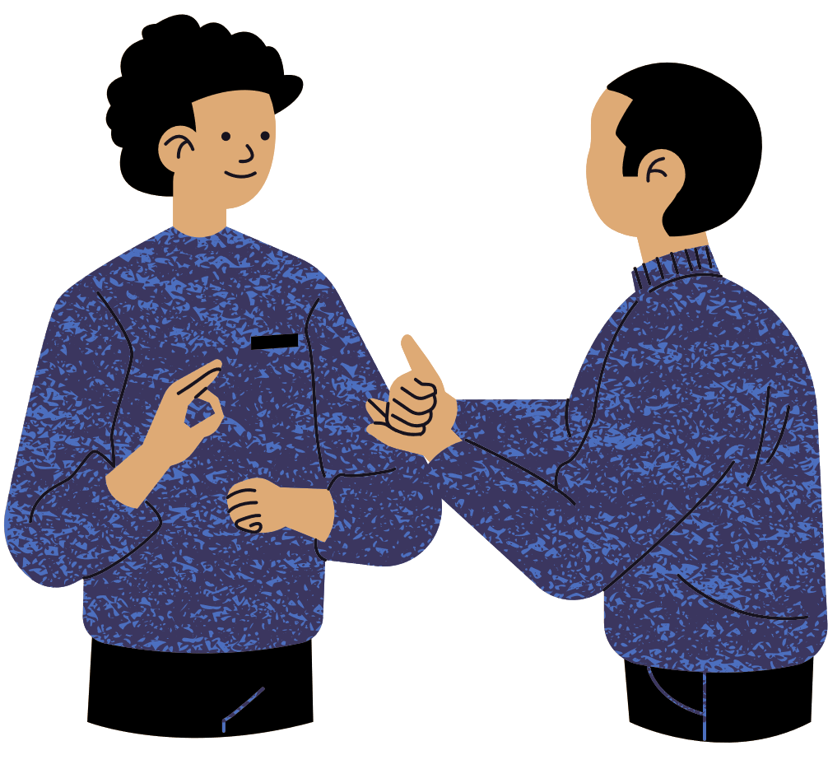
Thank you for your attention

